Slide 1


Super resolution model to improve sandstone image quality using transfer learning
Paulo André de Mesquita e Bomfim Leite de Castro
Vinicius Rabello Rodrigues
R. ArefiDamghani
H.R. Anbarlooei

Slide 2
These are for you to read!
Digital rock analysis is a cutting-edge approach to analyzing and investigating rock samples by harnessing the power of computers and digital technology. By subjecting rock samples to digital processing, valuable insights into rock porosity structure, rock attributes, and formation properties can be derived
The future research direction and prospects for applying digital rock technology lie in the integration of micro-pore models with macroscopic geological understanding across different scales. Expensive and scarce geological samples from specific areas, along with the significant heterogeneity of rock formations, constitute major limiting factors for this development. Extending the results of a small and homogeneous digital rock simulation to the entire geological area is not feasible, let alone as an effective database for geological statistical modeling
The conventional approach to three-dimensional (3D) digital rock modeling combines computer tomography (CT), and focused ion beam scanning electron microscopy (FIB-SEM) to directly acquire high-resolution 3D digital rock samples through image processing. This method is the predominant experimental approach for analyzing micro-properties of rocks as it reconstructs 3D digital rocks that accurately represent the pore structure. However, the high cost, instrument limitations, and inadequate knowledge of rock sample preparation and analysis represent barriers to large-scale acquisition.
Although these techniques can significantly augment the quantity of 3D digital rock samples, they are limited in their ability to generate structurally varied samples and fully encompass the complexity of porous structures. Therefore, conducting an efficient, low-cost, and highly diverse digital rock generation study is crucial.
https://www.sciencedirect.com/science/article/pii/S0098300424000244

Slide 3
These are for you to read!
Reservoir dynamic performance is affected by subseismic (below the resolution of seismic imaging) geologic features such as submeter thin barriers and baffles, or high-permeability streaks, and porous media properties.
Although they cannot be predicted with absolute certainty, there are strategies that can improve estimates of the prevalence and connectivity of these thin features. Additionally, to capture the range of uncertainty, one can create different subsurface realizations and scenarios that all align with the available data and use them to produce a range of predicted flow
The key challenge in exploring full subsurface uncertainty space within geological and geophysical constraints is the generation of a multitude of reservoir architecture scenarios that are consistent with all available seismic and well-log data.
Improving Reservoir Characterization and Prediction Via Machine Learning-Driven Integration of Subseismic Geologic Concepts, Geophysical Attributes, and Wells

Slide 4


Why?
Reservoir dynamic performance
Affected by seismic and sub-seismic geologic features
i.e. sub-meter thin barriers and baffles, high-permeability streaks,
or sub-centimeter pore structure
Modeling Challenges
Impossible to predicted/modeled exactly (uncertainty)
Different subsurface realizations, consistent with all available seismic and well-log data,
Generate/explore different possible pore structures,

Slide 5
Why?
Digital Rock
Studying rocks harnessing power of computation,
Rock porosity structure, rock attributes, and formation properties,
Integrating micro-pore models with large-scale geological data across various scales,
Computer tomography (CT), and focused ion beam scanning electron microscopy (FIB-SEM).
Challenges
High costs and limited availability of geological samples from specific regions,
Considerable heterogeneity of rock formations,
Elevated costs, equipment limitations,
Insufficient expertise in rock sample preparation and analysis.
Generalize the outcomes of a small and uniform digital rock simulation to the entire reservoir!

Slide 6
We explored 2 Solutions!
2D slice generator?
In the oil and gas industry, obtaining high-quality underground images is essential for optimizing resource extraction, but it is often constrained by high costs and technical limitations.
The trade-off between higher resolution images and the associated complexities and costs highlights the need for cost-effective and efficient alternatives
Super-Resolution as a Solution
Recent advancements in SR have been applied to digital rock imaging, such as sandstone and carbonate samples, where a variety of models have been successful in improving resolution. However, these techniques still require large datasets of low and high-resolution images for effective training.
To address this challenge, our study introduces the use of synthetic data generation combined with transfer learning.

Slide 7

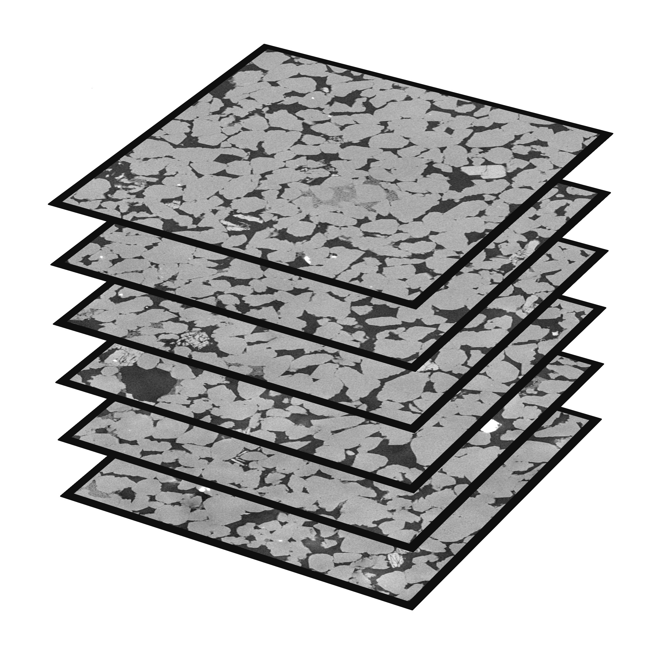
Dataset used
Dataset overview
Source: Super Resolution Dataset of Digital Rocks (DRSRD1-2D) by Wang, Armstrong, et al. (2019)
Content: Collection of 1000 high-resolution images of Bentheimer sandstone
Process: Images downsampled by 8x to create low-quality version

Slide 8
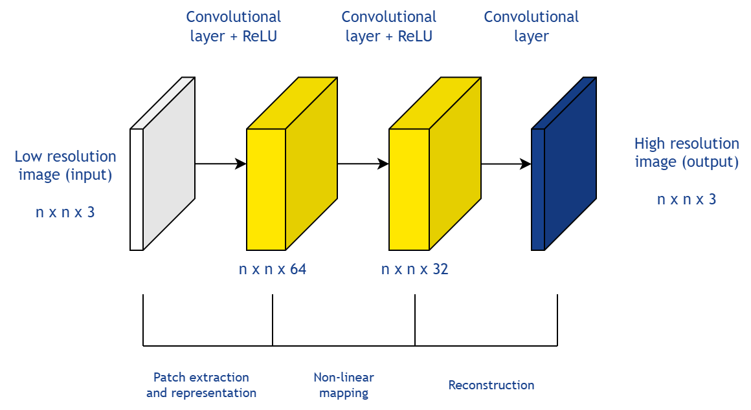
SRCNN: Super-resolution convolutional neural network
Architecture
Layer 1: Extracts image patches
Layer 2: Non-linear mapping from low-resolution to high-resolution images
Layer 3: High-resolution image reconstruction
Advantages:
Simplified implementation and understanding
Reduced computational resource requirements
Accelerated output generation

Slide 9
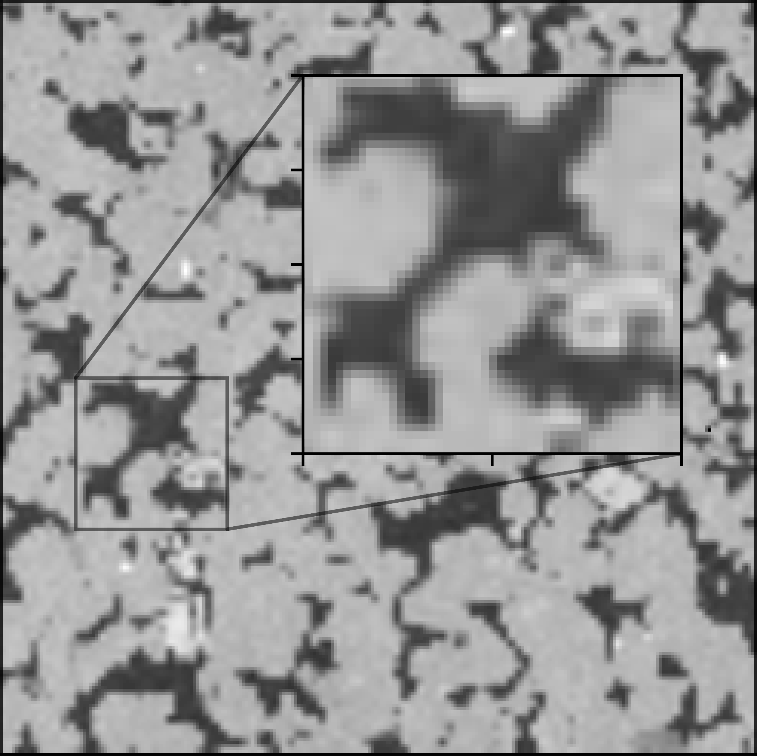
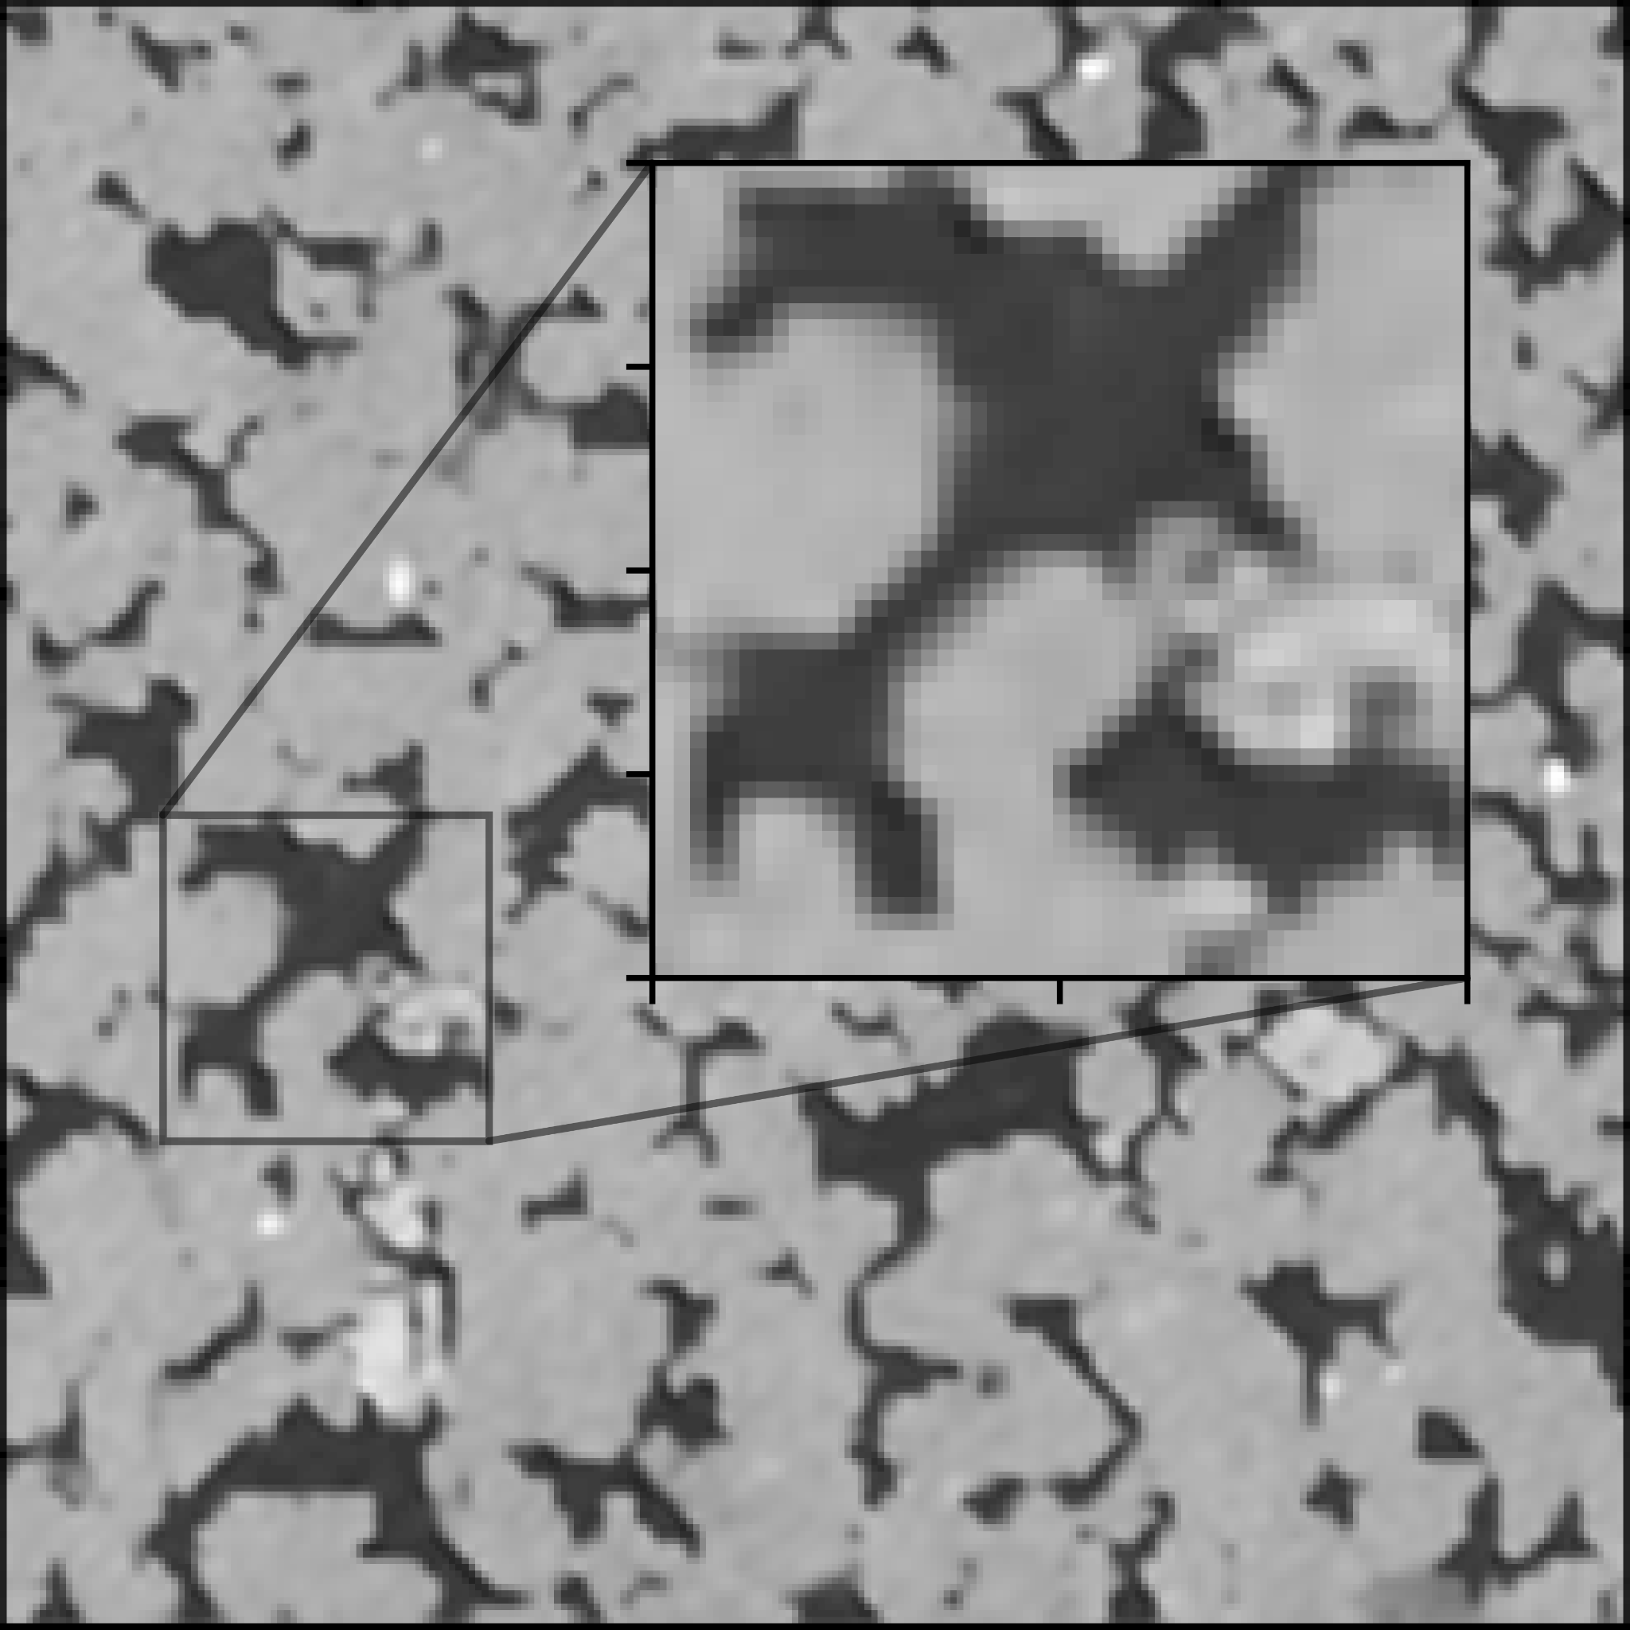
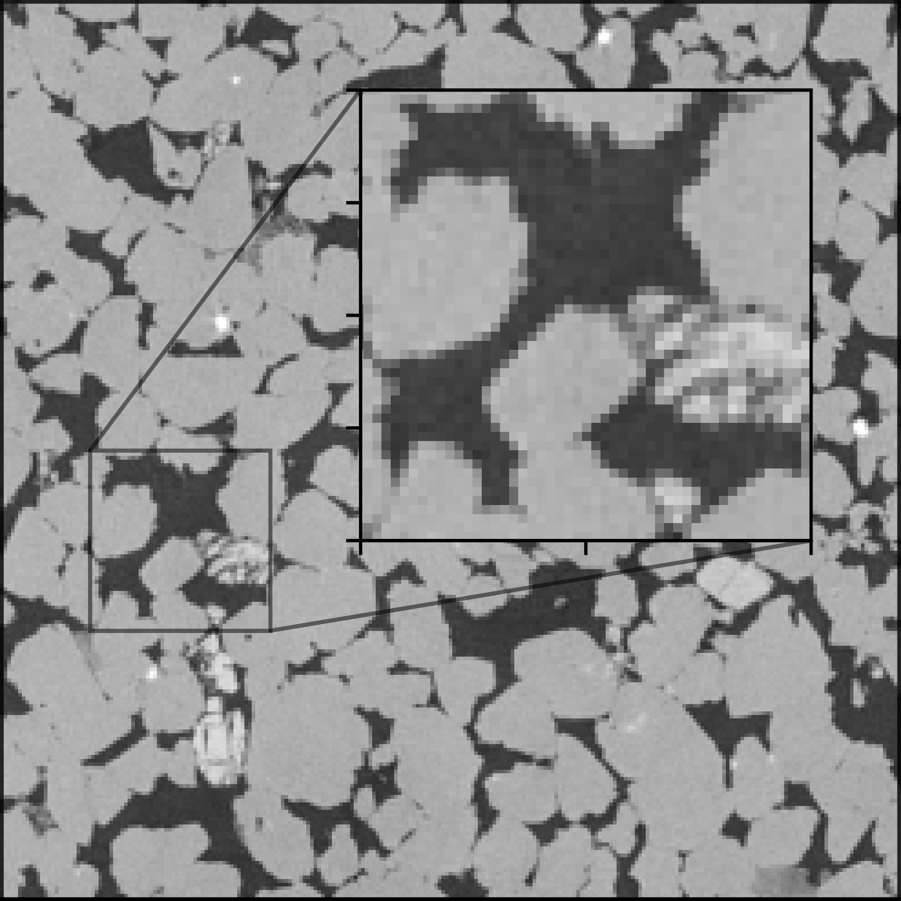
Training SRCNN model on the
dataset
LR image Model output HR image
Figures, Images, Charts or Tables
Not that good, metion that by transfer learning we make it better

Slide 10
Problems of training neural
networks with limited data
Insufficient data for robust training
Risk of overfitting
Lack of diversity
Transition to transfer learning
Solution: Transfer learning offers a different approach to sidestepping these challenges by leveraging knowledge from pre-trained models on similar tasks.
High-cost of data acquisition
Financial constraints
Time-consuming process of gathering and labeling new data

Slide 11
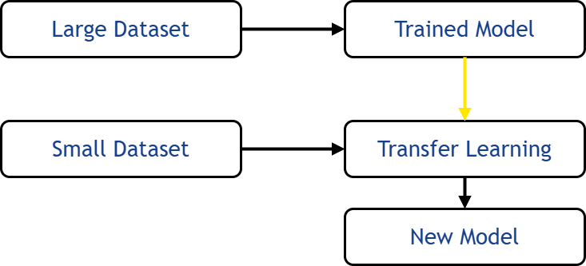
Transfer learning to
overcome such difficulties
Main idea:
Utilizes a pre-trained model to transfer knowledge from a larger synthetic dataset to the primary neural network
Application in SRCNN:
Base model: Trained on synthesized data
SRCNN: Gains broader training data and relevant features from the base model
Benefits
Reduces the need for extensive real data collection
Enables the model ability to generalize with small dataset

Slide 12
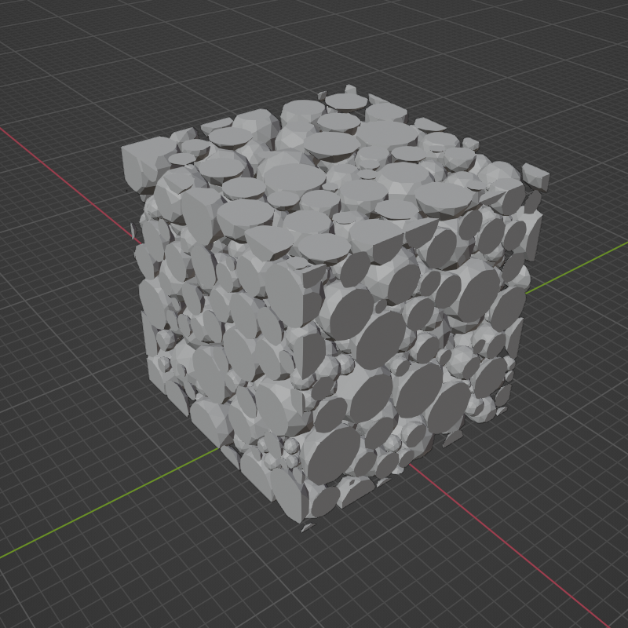
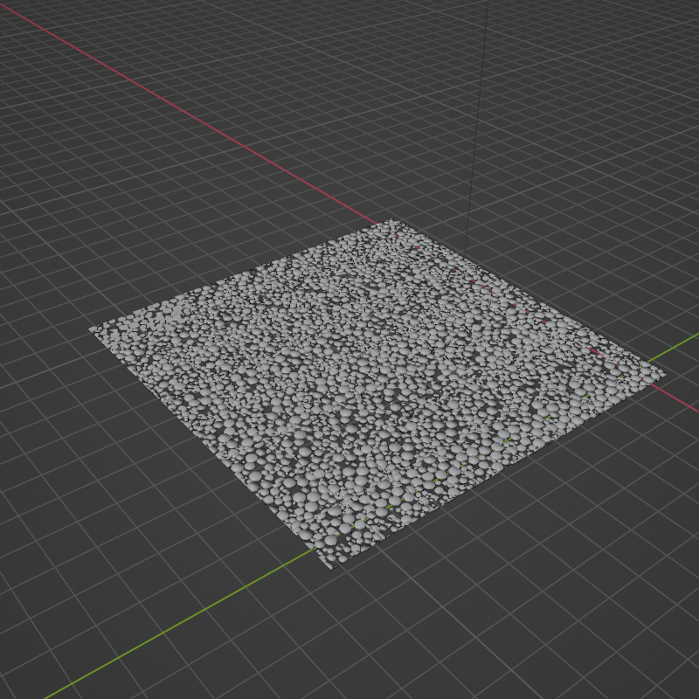
Challenge: how to create data that simulate the real images
Concept
Sandstone grains approximated as spheres with random sizes
Filled a cube (rock sample) in a random distribution
3D model creation
Simples collision detection technique used to generate the 3D model
Model sliced into 2D images for low and high-resolution data
After this a shell image should also come

Slide 13
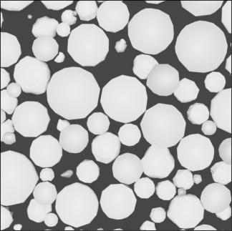

Challenge: how to create data that simulate the real images
Data generation
Enable rapid generation of large volumes of data
Provides efficient data creation within a short timeframe
Data generation
After image processing
Image processing
Applied a binary filter to the images
white regions represent rock; black regions represent pores
Simplification facilitates and streamlines the training process

Slide 14
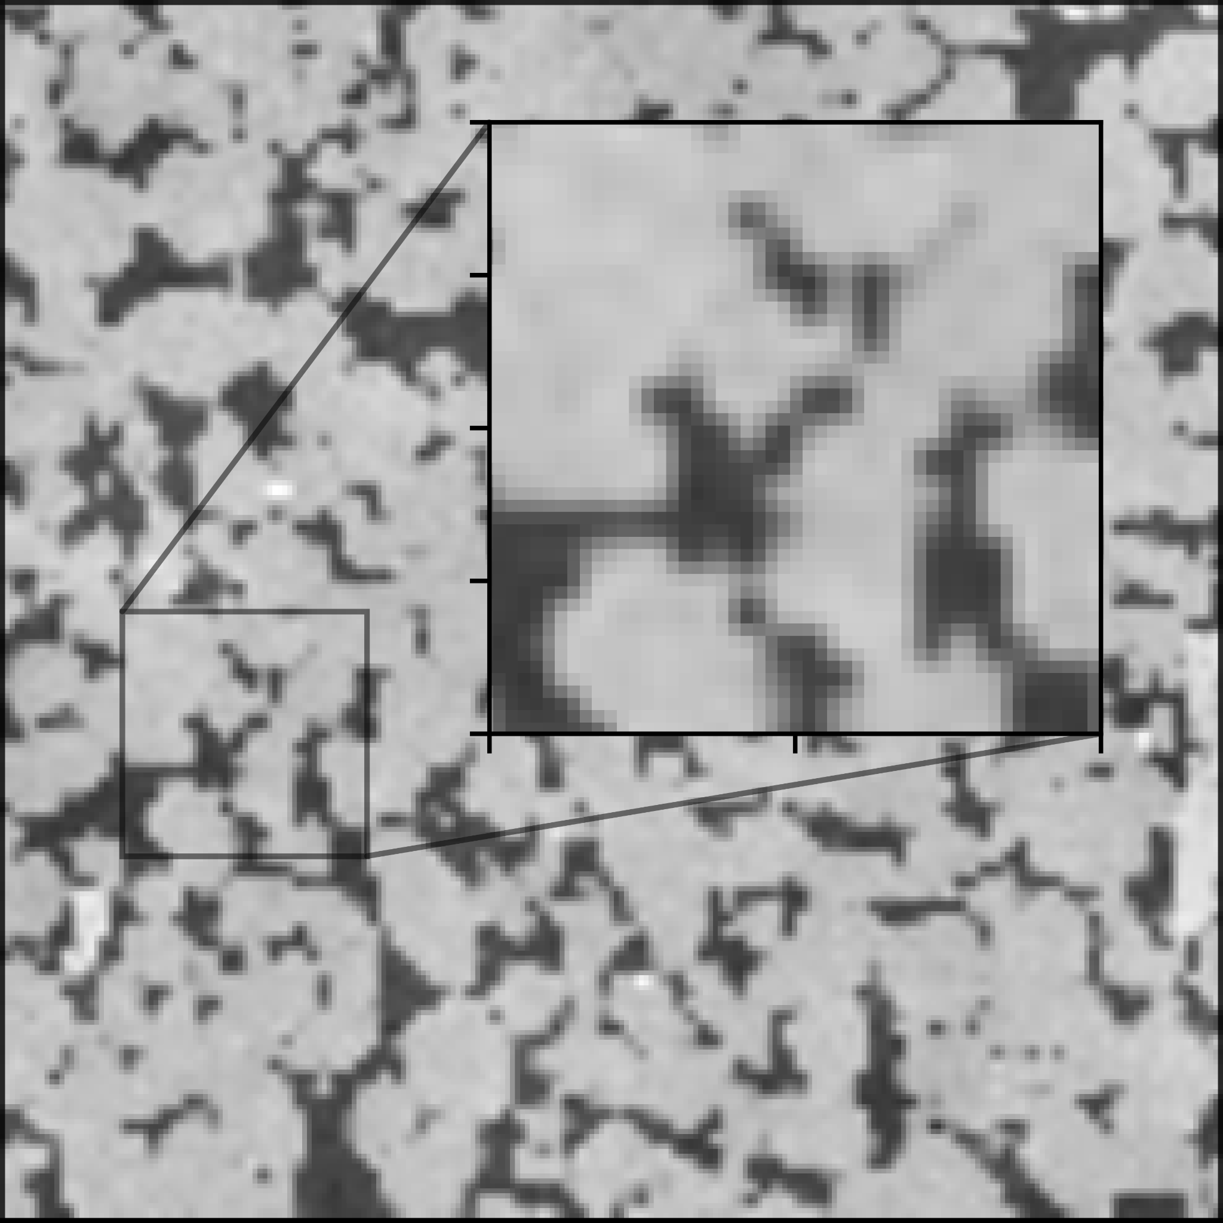
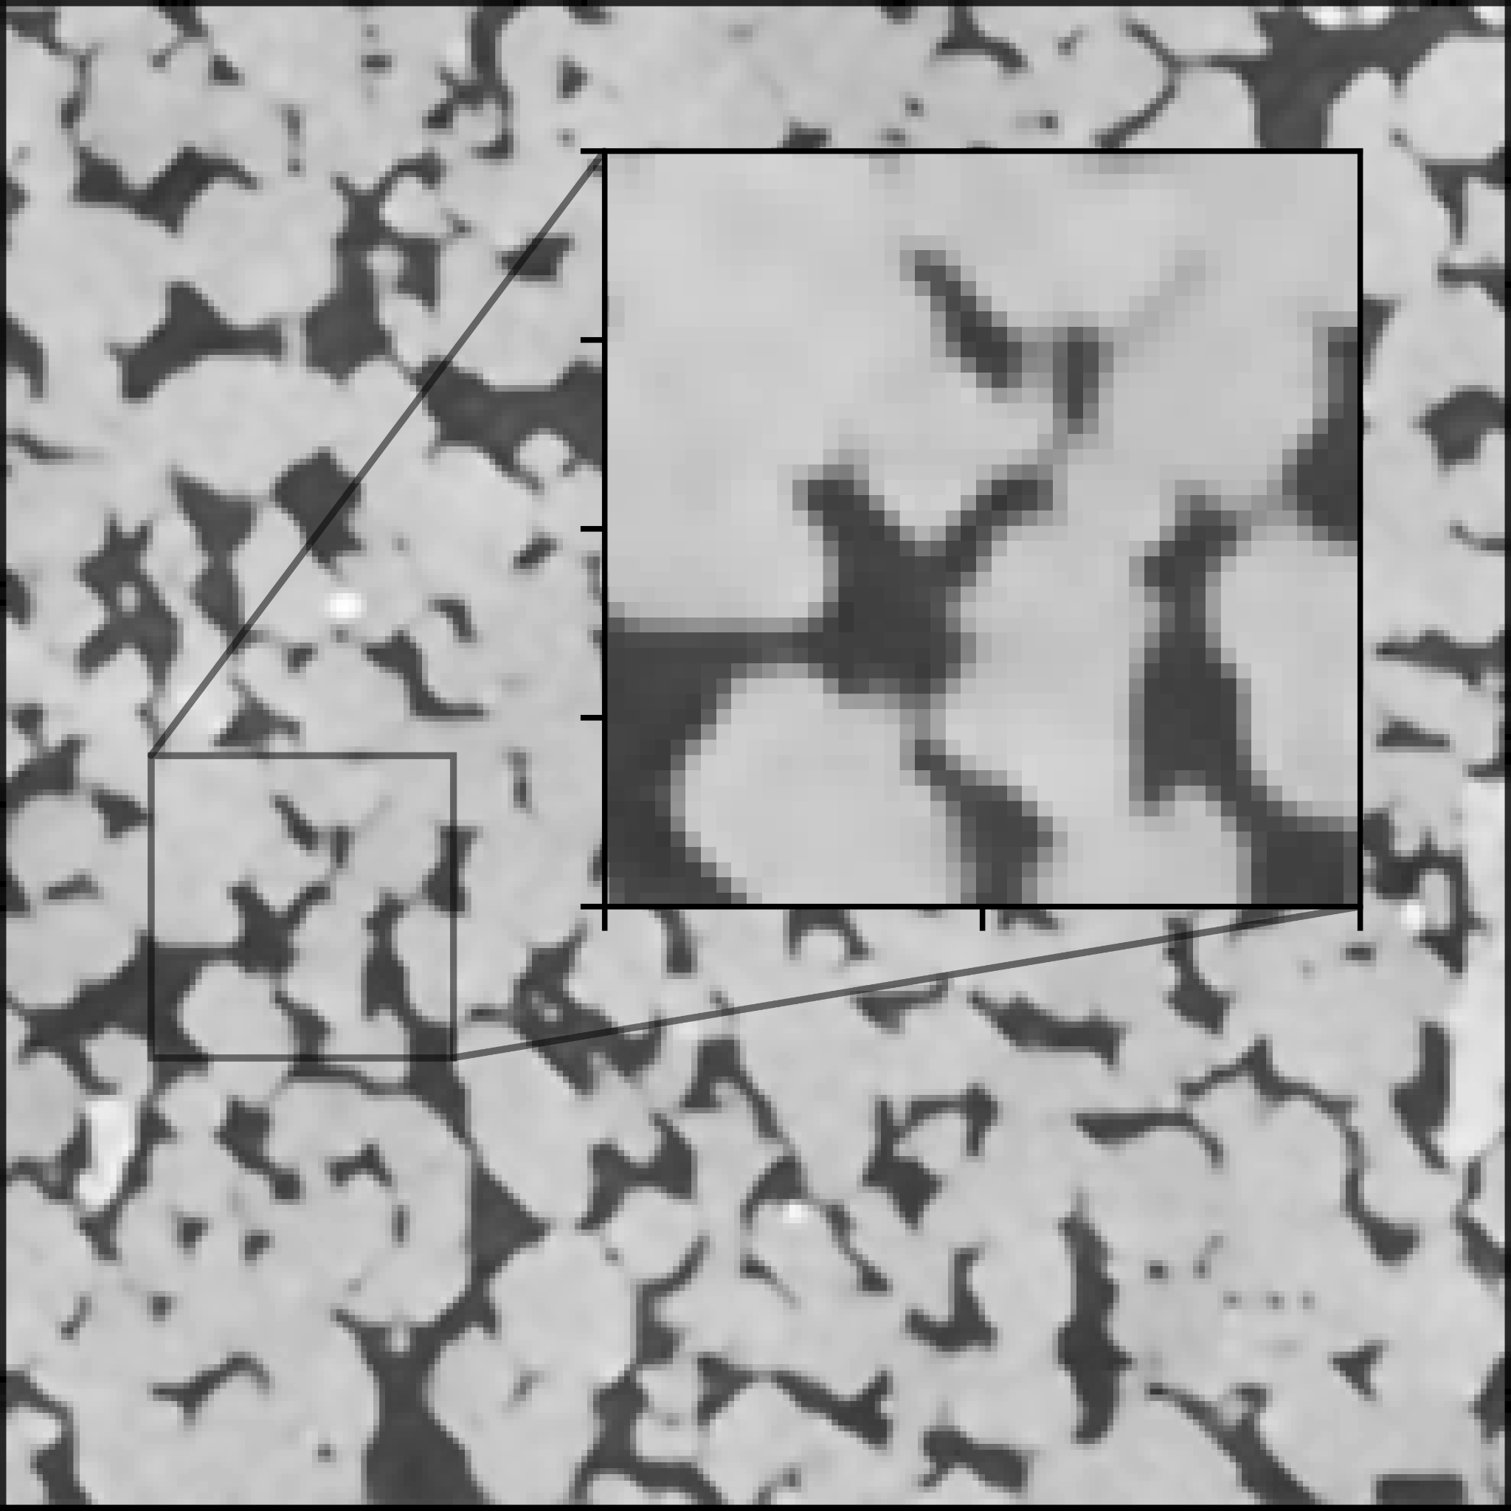
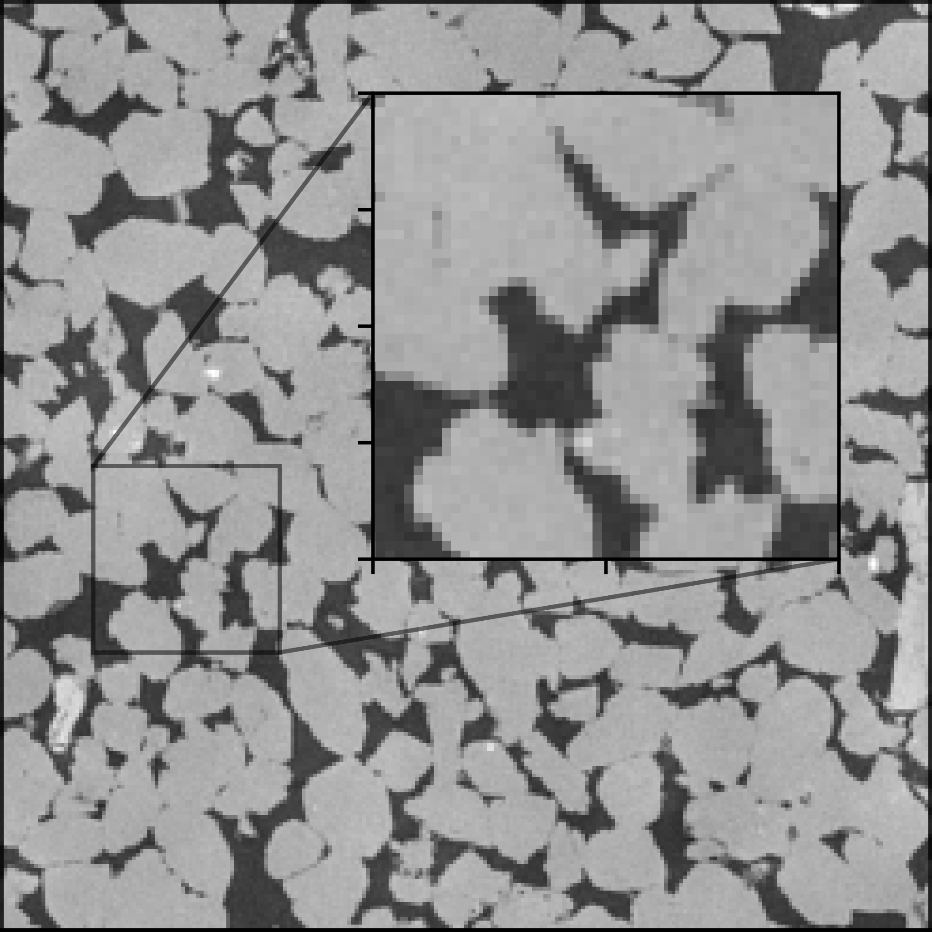
SRCNN model using transfer
learning
16408C
LR image Model output HR image
Figures, Images, Charts or Tables
Bring the numbers also

Slide 15
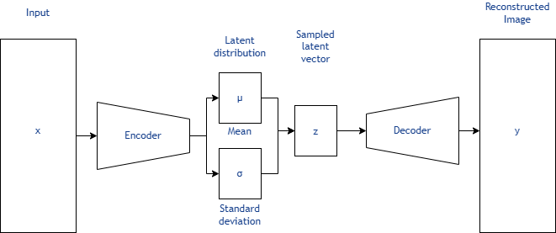
New results: Enhancing data
accuracy with variational autoencoder (VAE)
Definition
A generative model that learns to encode data into a latent space and then decode it back to the original space.
Components
Encoder: Compresses input data into a latent representation
Latent space: a lower-dimensional representation where complex data, like images, are encoded as points.
Decoder: Reconstructs the data from the latent representation

Slide 16
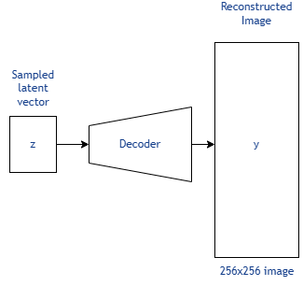
Representing an image as a point
in space
Decoder function
The decoder takes a latent vector as input and outputs the original image. This process can be interpreted as a function ƒ: ℝ³→𝐗, where 𝐗 is the set of 256x256 images
Recontextualizing a rock
Using this interpretation, a rock can be visualized as a continuous path in 3D space within the latent space.

Slide 17
Show one example of generated image here! Or add movie to the next slide!
Show two/three images with different latent variables on the side to show the effect of it.

Slide 18
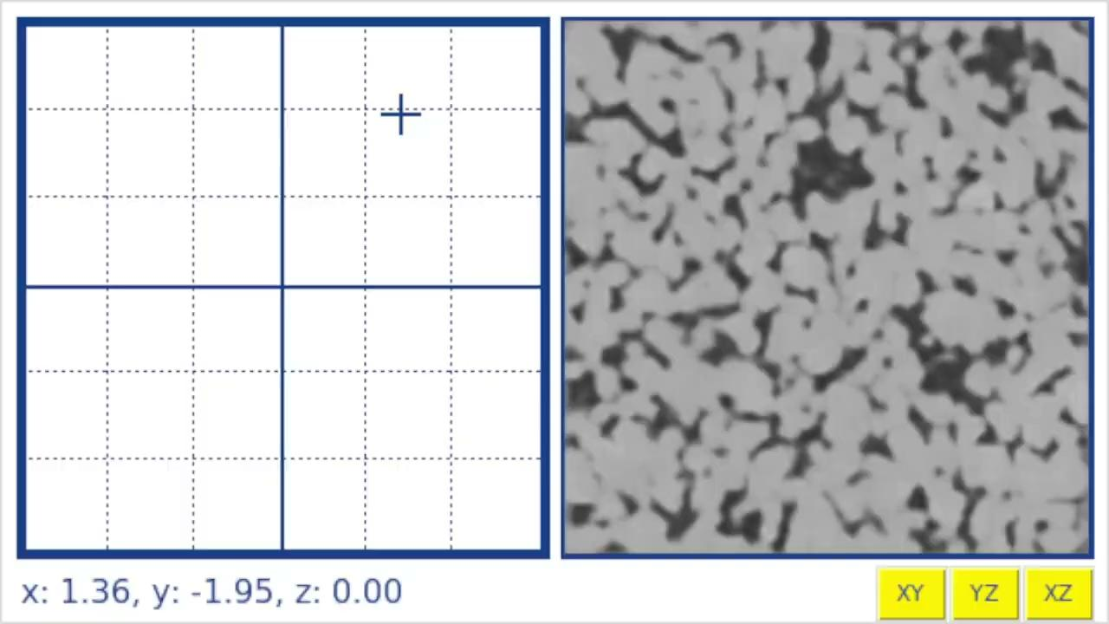
Output examples of the VAE

Slide 19
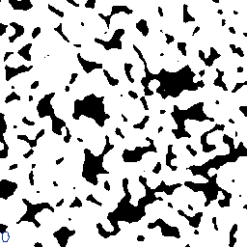
Continuity of synthetic data
from VAE
Constructing sequential slices of synthetic data:
Linear Interpolation: Generated new slices by interpolating the encodings of two sequential images, A and B, from the dataset, resulting in a new image C
Flexible Slice Generation: Enabled the creation of multiple slices between any two images, maintaining consistency and similarity with the original dataset

Slide 20
Here talk about the idea we had.
Just take 1/10 of images, and use linear interpolation to generate the connecting images
Say, combining these two NN, we can have lower resolution images and also less images
Then mention that these linear connection seems not good.
We have trained just on 2d images, losing 3d connection between images.
But what happens when we give an stack of images and see how the latent variable changes in space? Is it going to be random?

Slide 21
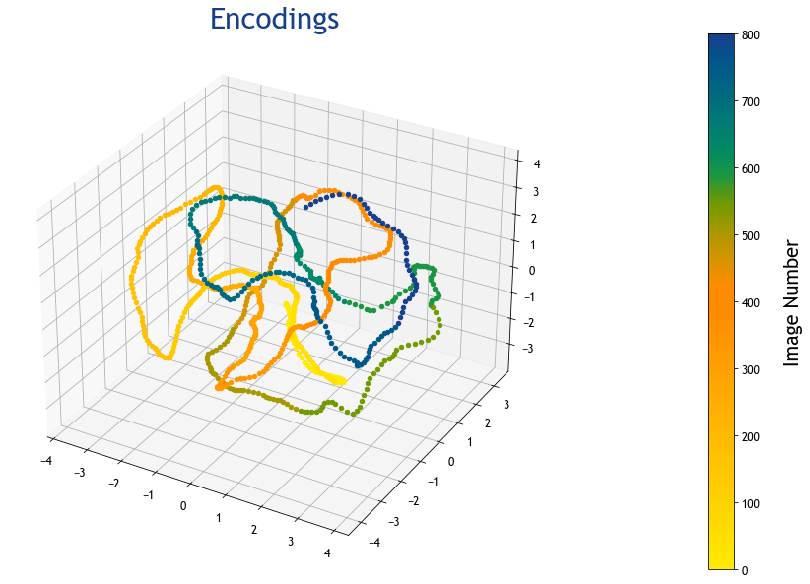
Dataset distribution in latent
space
Implications for Data Generation
Linear Interpolation for Nearby Points: Provides accurate approximation for generating new images when points are close to the dataset’s curve
Careful sampling required: Ensures generated data points remain near the dataset’s curve in latent space to maintain data quality

Slide 22
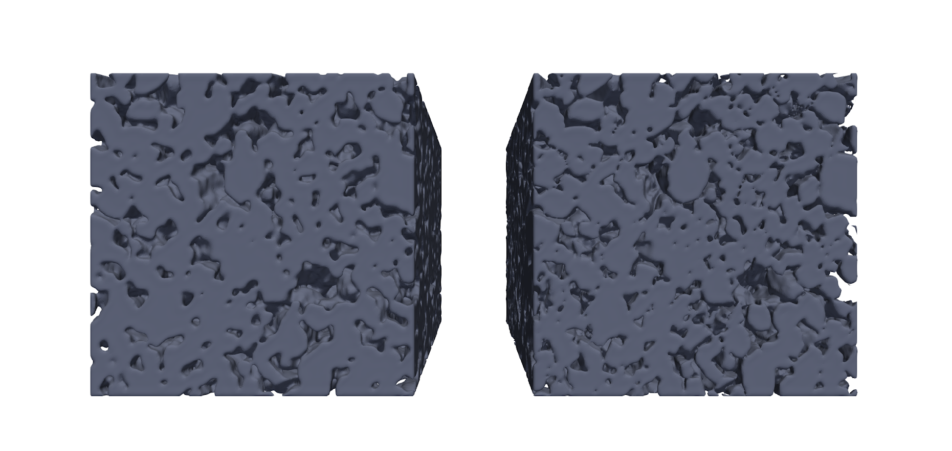
Validating synthetic data
recreating the 3D model
Reconstruction of a 3D model using synthetic data
Using the slices, we were able to create a new 3D model that is similar to the original, maintaining most of the characteristics of the pores.
This model can be used to validate the VAE output by comparing relevant metrics, such as porosity or permeability, with those of the 3D model of the dataset

Slide 23
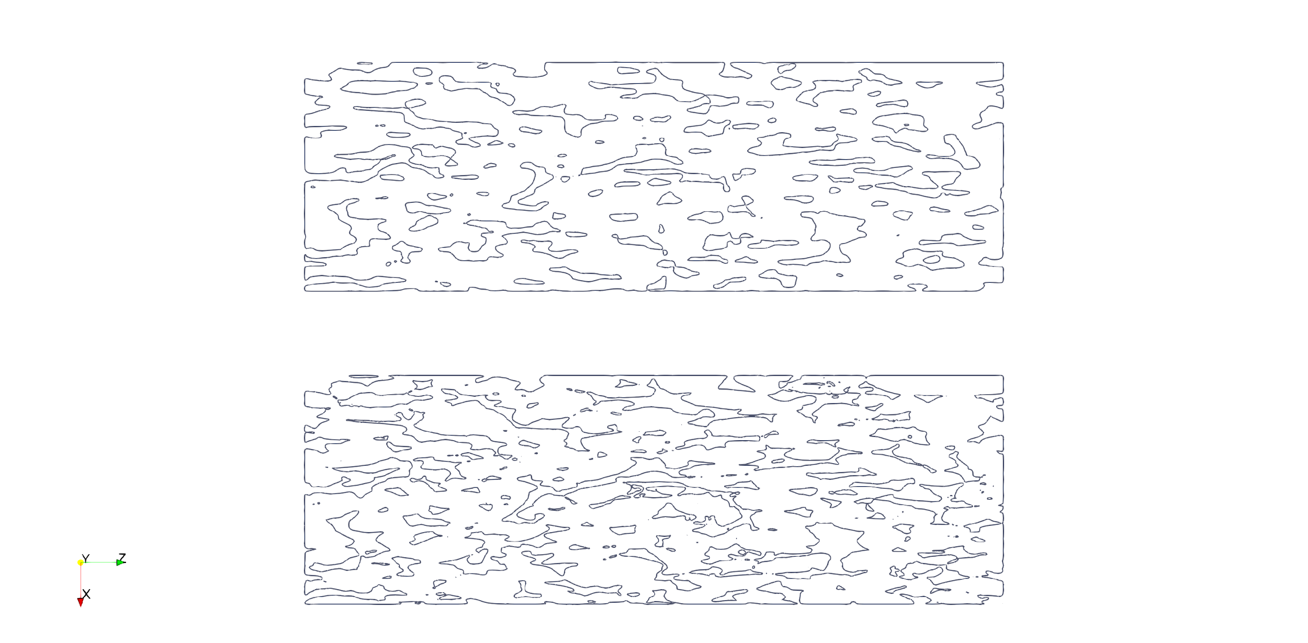
3D model comparisons
Performance visualization
To evaluate the performance, a cross-sectional cut of was made in a direction perpendicular to the original slices.
Top image: 3D model reconstructed using synthetic data generated by the VAE
Bottom image: 3D model reconstructed using only the original dataset

Slide 24


Access all
Conference Papers
IBP Digital Library
biblioteca.ibp.org.br

Slide 25
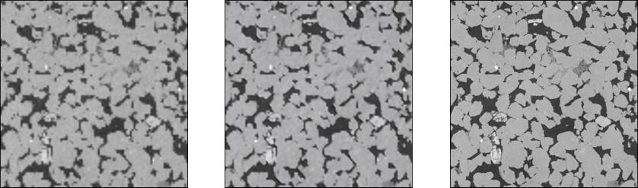
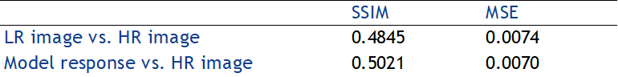
SRCNN output results
LR image Model output HR image
Figures, Images, Charts or Tables

Slide 26
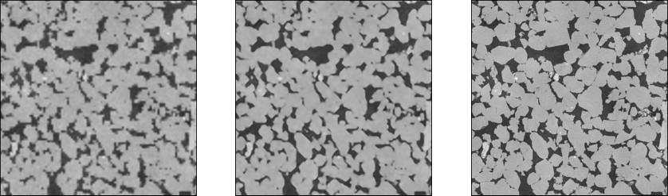
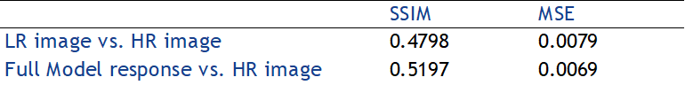
Transfer learning output results
16408C
LR image Model output HR image
Figures, Images, Charts or Tables

